Slide 1
Disclaimer/s
We hope you find the information on our website and resources useful.
Animations
This resource has been designed with animations to make it as fun and engaging as possible. To view the content in the correct formatting, please view the PowerPoint in ‘slide show mode’. This takes you from desktop to presentation mode. If you view the slides out of ‘slide show mode’, you may find that some of the text and images overlap each other and/or are difficult to read.
To enter slide show mode, go to the slide show menu tab and select either from beginning or from current slide.
You may wish to delete this slide before beginning the presentation.

Slide 3
Types of Articles
Articles are used in a multitude of ways including:
Newspaper Articles
TV News Articles
Magazine Articles
Exposé

Slide 4
Features of an article
Headline
Something eye catching that hooks the reader in. Some authors will use clickbait or shock tactics to lure the reader in. A headline is usually in a large font.
Byline
Basically answers the question “Who wrote this?” Not all articles have this.
Captions
Sentences under pictures that explain what is happening in the picture.
Pictures or Images
Creates interest for the reader and helps them to make connections between what they are reading and what they already know. Images are also used to hook readers in.

Slide 5
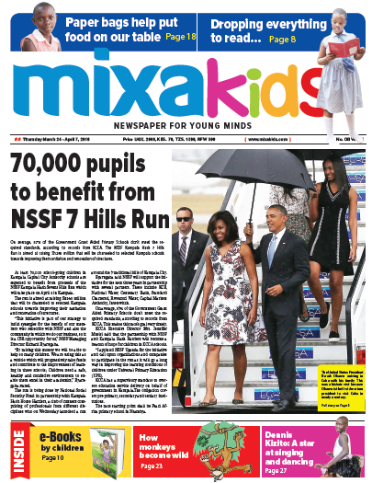
Title of the newspaper
Headline
Images
Caption

Slide 6
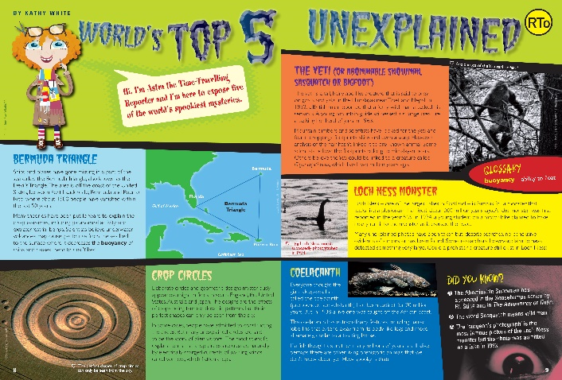
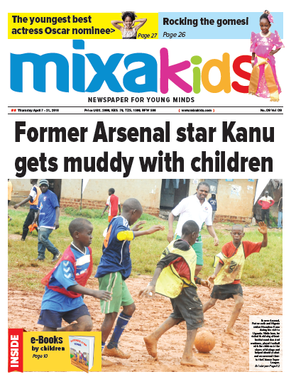
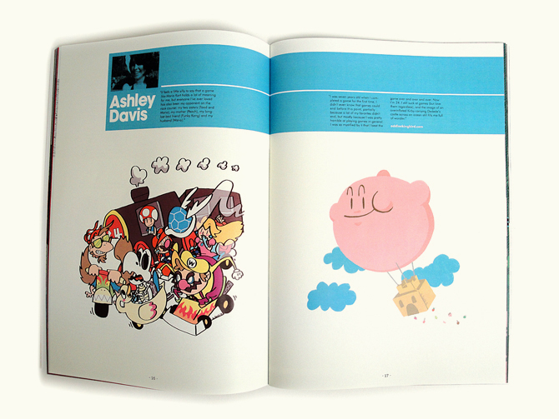

Layouts
“Explore Magazine” by [Dani Bauman Designs 2010] is licensed under CC BY 2.0
“The Controller Final Print” by [Cory Schmitz] is licensed under CC BY 2.0
Different newspapers and articles have different ways of setting out information visually. Look at the different layouts and discuss what you do and don't like about them.
“Midterm Project - Magazine Spread” by [Daphne Delacruz] is licensed under CC BY 2.0

Slide 7
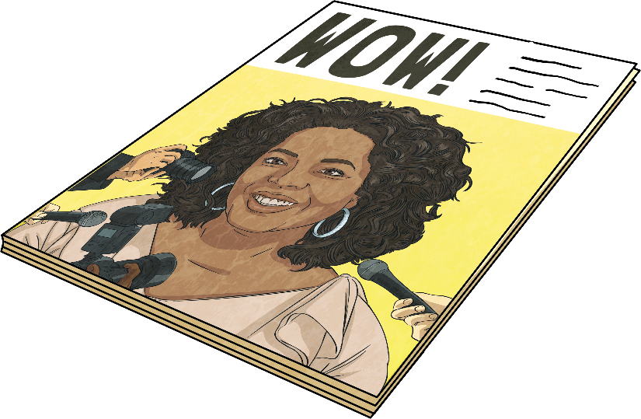
Text Features of an Article
Depending on the article, it usually is written:
In the third person point of view;
Formally - it often doesn't have colloquial language or phrases;
In paragraphs - one main idea per paragraph;
Factually - articles can’t have made up information in them;
In the present tense.

Slide 8

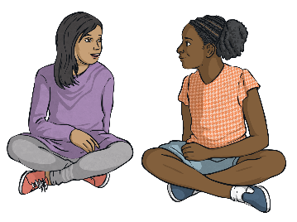
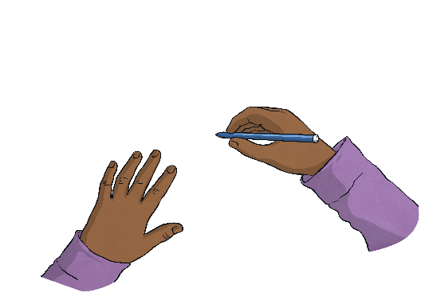
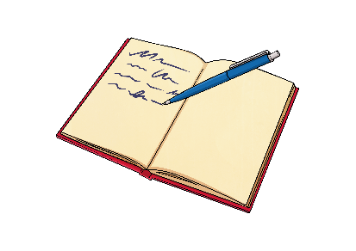
Writing Time
Now that you know what you need in an article it is time to get writing. Follow the steps to help you get started.
1
2
Think of an issue, person or topic you think your reader will enjoy.
Research, find facts, interview experts and people about their opinions.
3
4
Record notes as you go (this will help you when it's time to write).
Plan your writing using a template.

Slide 9
Writing Time
Now that you know what you need in an article it is time to get writing. Follow the steps to help you get started.
1
2
22 million on island/nearly all lost power/monkey got into the grid transformer.
Nationwide power outage in Sri Lanka blamed on monkey.
3
4
Power was returned quickly but some had to wait til Sunday evening.
very old system/frequent cuts/ government not investing

Slide 10
Nationwide power outage in Sri Lanka blamed on monkey
By Julia
A monkey was blamed for causing a nationwide blackout in Sri Lanka on the weekend.
This weekend Sri Lanka had an unusual electricity problem. The island nation's 22 million residents were mostly left without power during the outage, which began around 11am local time on Sunday. A monkey came into contact with a grid transformer, causing an imbalance in the system. A lot of problems were caused by this monkey.
Sri Lanka has suffered issues with its electrical system before. Engineers have been warning consecutive governments to upgrade the system or face frequent blackouts for years. The national power grid is in such a weakened state that frequent island power outages may be expected if there is another disturbance. This is really annoying for residents.
Power was returned to some areas within hours, but many households were without electricity until late on Sunday. “Only in Sri Lanka can a group of monkeys fighting inside a power station cause an island wide power outage," Jamila Husain. It was lucky it was a Sunday. Next time it could be a working day which would be much worse.

